Slide 1
THEME 2: SCHOOL
Lesson 1
Lesson 3
Lesson 5
Lesson 2
Lesson 4

Slide 2
i-Learn Smart World 6 – Theme 2
Page 14

Slide 3
i-Learn Smart World 6 – Theme 2
4
8
5
6
7
3
2
Page 14
Notes:
Step 1: introduce some basic subjects at school
Step 2: teach new vocabularies
Step 3: Practice those vocabularies

Slide 4
i-Learn Smart World 6 – Theme 2
?
art
geography
?
?
favorite
?
subjects
geography
?
Page 14
Notes:
Step 1: predict what they are going to listen
Step 2: listen
Step 3: practice

Slide 5
i-Learn Smart World 6 – Theme 2
Page 14
Notes:
Step 1: divide class into pairs.
Step 2: practice ask and answer about their favorite subjects at school.

Slide 6
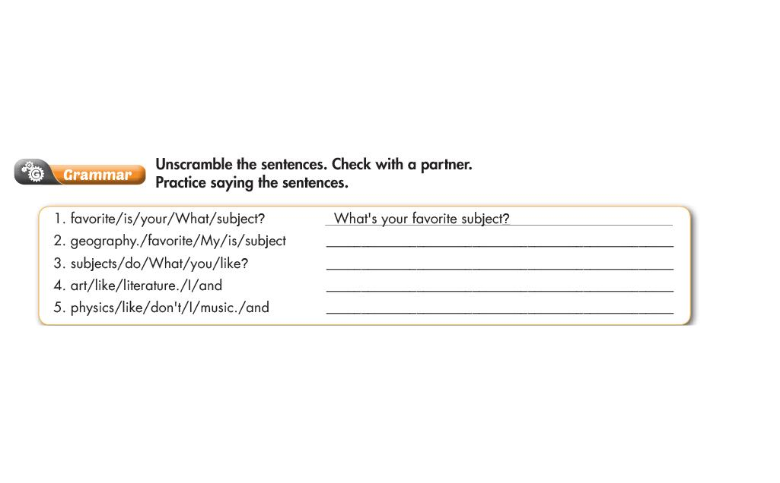
i-Learn Smart World 6 – Theme 2
My favorite subject is geography.
?
What subjects do you like?
?
I like art and literature.
?
I don’t like physics and music.
?
Page 15

Slide 7
i-Learn Smart World 6 – Theme 2
Page 15
Notes:
Step 1: Listen for the intonation
Step 2: listen and repeat the intonation
Step 3: practice in pairs
I.T.: information technology

Slide 8
i-Learn Smart World 6 – Theme 2
Page 15
Notes:
Step 1: Divide class into group of 4
Step 2: ask and take note their favorite subjects in groups
Step 3: present

Slide 9
i-Learn Smart World 6 – Theme 2
Page 16

Slide 10
i-Learn Smart World 6 – Theme 2
Page 16
Notes:
Step 1: introduce new subjects
Step 2: explain the new words
Step 3: listen and repeat
Step 4: talk about their 3 activities at school

Slide 11
i-Learn Smart World 6 – Theme 2
False
False
False
Page 16

Slide 12
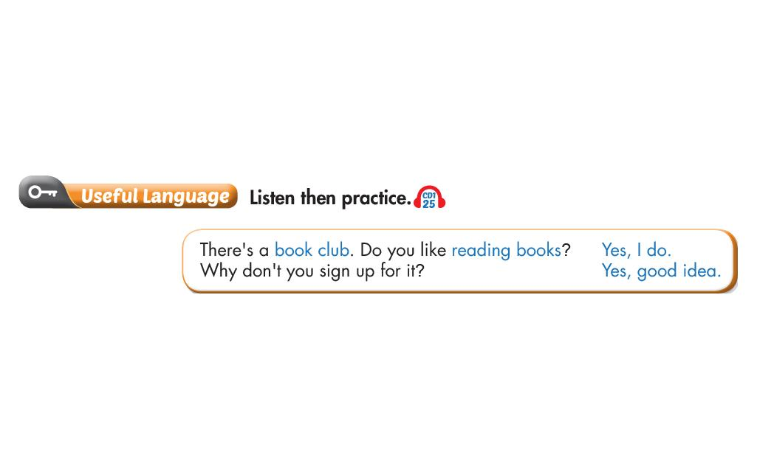
i-Learn Smart World 6 – Theme 2
Page 16
Notes:
Step 1; Listen
Step 2: Practice in pair about their school clubs

Slide 13
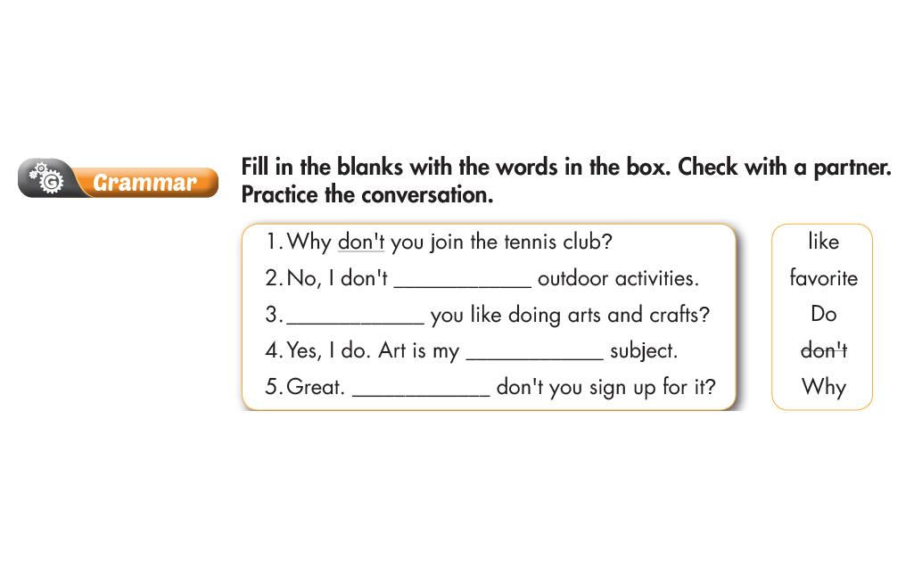
i-Learn Smart World 6 – Theme 2
?
like
Do
?
?
favorite
Why
?
Page 17
Notes:
Step 1: Review the simple present tense
Step 2: practice

Slide 14
i-Learn Smart World 6 – Theme 2
Page 17
Notes:
Step 1: listen
Step 2: repeat the intonation
Step 3: practice the conversation in pairs

Slide 15
i-Learn Smart World 6 – Theme 2
Page 17
Notes:
Step 1: divide class into pairs
Step 2: practice ask and answer about choosing school activities. Applying the present simple tense.
Step 3: present

Slide 16
i-Learn Smart World 6 – Theme 2
d
f
?
?
c
?
?
e
a
?
Page 18
Notes:
Step 1: introduce the new lesson
Step 2: teach new words
Step 3: share with the class

Slide 17
i-Learn Smart World 6 – Theme 2
Thiếu layout DTPO
sister
?
?
detective
clue
?
police
?
?
father
?
solve
mystery
?
Page 18

Slide 18
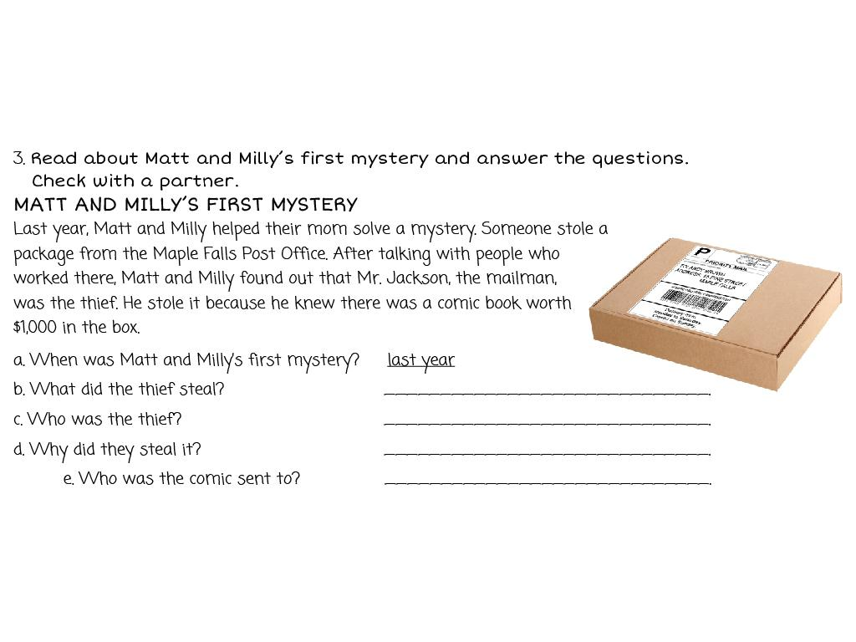
i-Learn Smart World 6 – Theme 2
a comic book
?
Mr.Jackson, the mailman
?
Because he knew there was a comic book worth $1000
?
Andy Brown
?
Page 18
Notes:
Step 1: introduce the letter
Step 2: read
Step 3: explain the simple past tense
Step 4: ask comprehensive questions

Slide 19
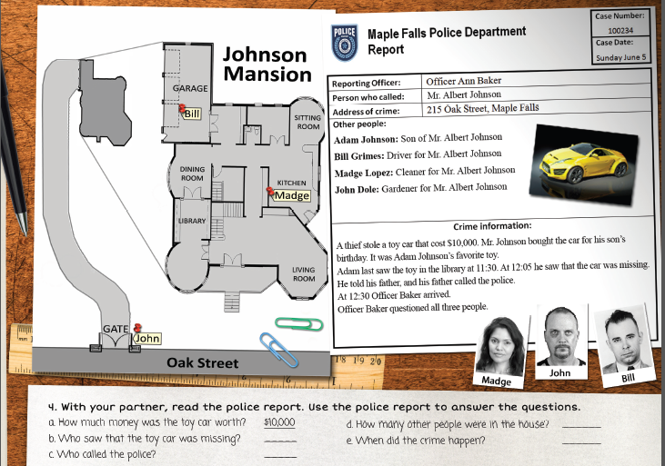
i-Learn Smart World 6 – Theme 2
?
3
?
Adam
On Sunday June 5
Mr. Albert
?
?
Page 19
Notes:
Step 1: read the map and the article
Step 2: explain new words
Step 3: ask comprehensive questions relating to the article

Slide 20
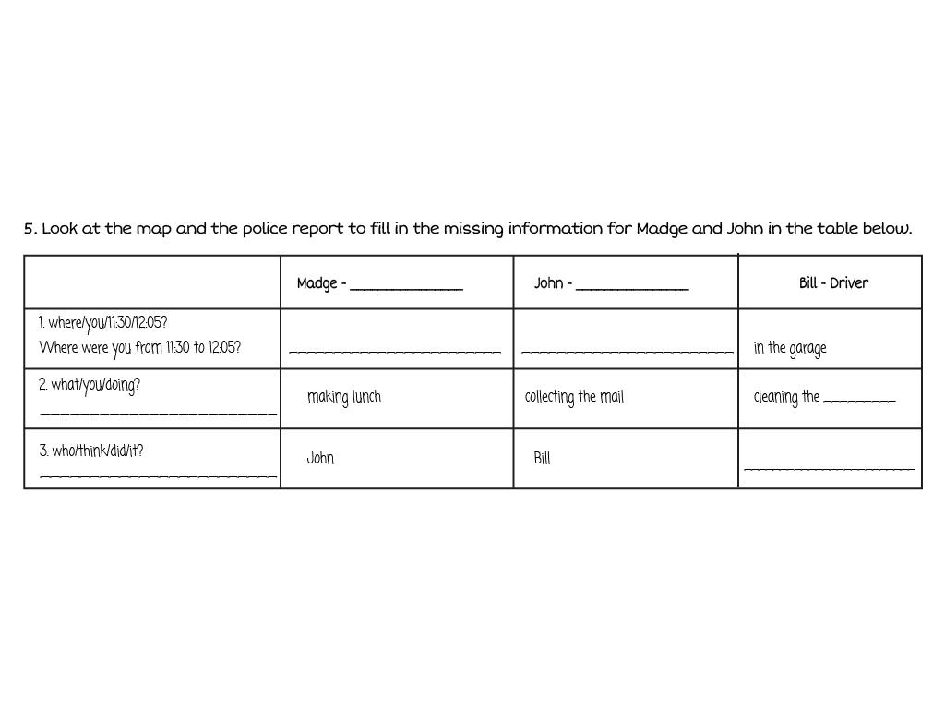
i-Learn Smart World 6 – Theme 2
Cleaner
?
?
Gardener
?
?
in the kitchen
at the gate
car
What were you doing?
?
?
?
Who do you think did it?
Madge
?
Page 19
Notes:
Step 1: fill in the missing information
Step 2: listen and check
Step 3: explain the Past continuous tense
Step 4: Practice in pairs using the Past continuous tense

Slide 21
i-Learn Smart World 6 – Theme 2
Page 19

Slide 22
i-Learn Smart World 6 – Theme 2
?
Bill
?
John
Because John likes expensive things
?
Page 19

Slide 23
i-Learn Smart World 6 – Theme 2
Page 19

Slide 24
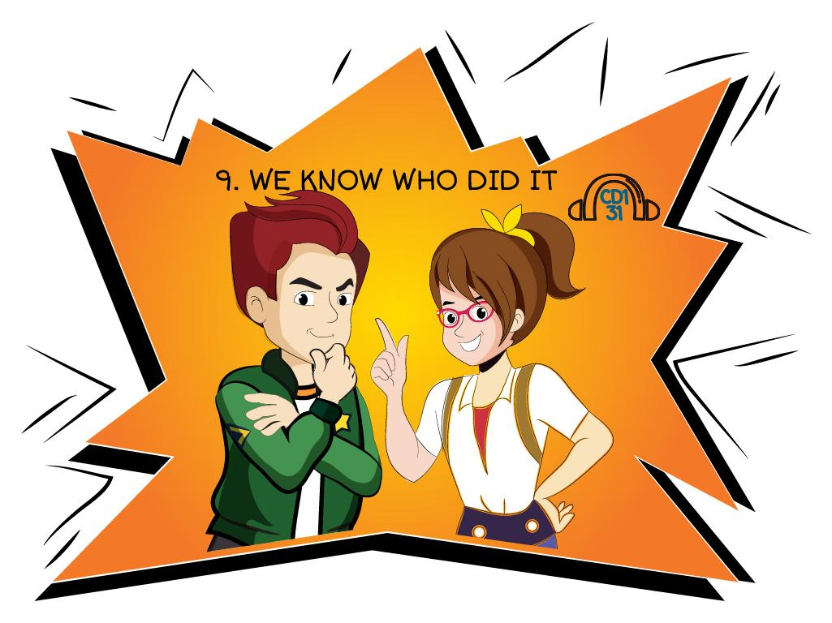
i-Learn Smart World 6 – Theme 2
Page 19

Slide 25
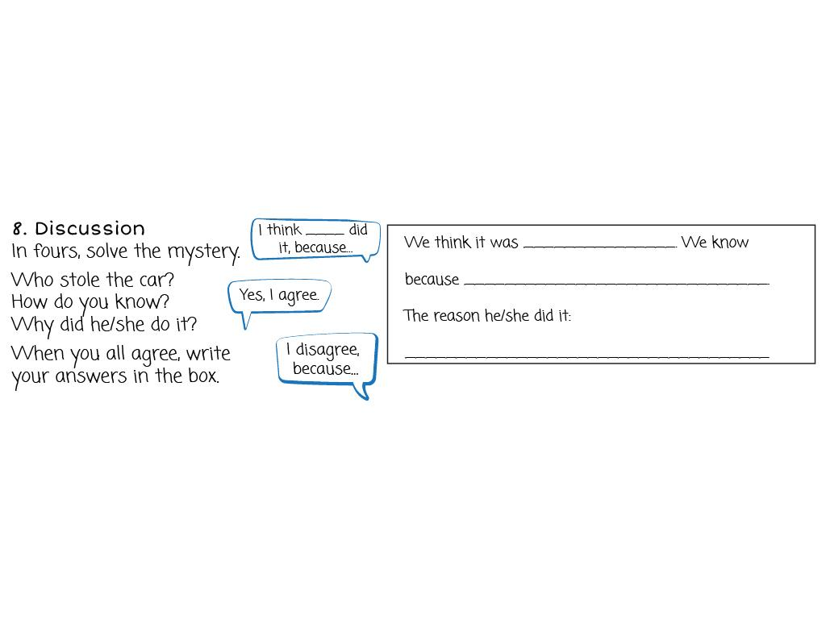
i-Learn Smart World 6 – Theme 2
?
John
He said he was collecting the mail but there is no mail on Sunday
?
?
The toy car worths $10.000
Page 19

Slide 26
i-Learn Smart World 6 – Theme 2
Page 20

Slide 27
i-Learn Smart World 6 – Theme 2
Page 20
Notes:
Step 1: explain the new words
Step 2: match the words with the descriptions
Step 3: listen and check

Slide 28
i-Learn Smart World 6 – Theme 2
?
battle
army
?
?
king
Page 20
Notes:
Step 1: introduce some Vietnamese heros
Step 2: Listen
Step 3: Check
Hero (male) -> heroine (female)

Slide 29
i-Learn Smart World 6 – Theme 2
Page 20
Notes:
Step 1: divide class into pairs
Step 2: practice ask and answer about their hero

Slide 30
i-Learn Smart World 6 – Theme 2
?
general
?
army
?
Battle
defeated
?
False
?
True
?
True
?
False
?
Page 21
Notes:
Step 1: scan for the main idea
Step 2: explain new words in the reading
Step 3: fill in the blanks
Step 4: check

Slide 31
i-Learn Smart World 6 – Theme 2
Page 21
Notes:
Step 1: divide class into pairs
Step 2: practice talking about 2 famous Vietnamese hero using the given information.
Step 3: present

Slide 32
i-Learn Smart World 6 – Theme 2
?
Body sentence 1
?
Body sentence 3
?
Conclusion
Page 21
Notes:
Step 1: introduce the new task
Step 2: explain each steps in the task
Step 3: practice

Slide 33
i-Learn Smart World 6 – Theme 2
Page 22

Slide 34
i-Learn Smart World 6 – Theme 2
Page 22

Slide 35
i-Learn Smart World 6 – Theme 2
Page 22

Slide 36
i-Learn Smart World 6 – Theme 2
Page 22

Slide 37
i-Learn Smart World 6 – Theme 2
Page 23
Notes:
Step 1: divide class into pairs
Step 2: do “Rock, scissors, paper”, the winning goes first
Step 3: Choose a box
Step 4: ask and answer correctly
Step 5: mark an X or an O
Step 6: the first pair gets 3 boxes in a row will win.

Slide 38
i-Learn Smart World 6 – Theme 2
Page 23

Slide 39
i-Learn Smart World 6 – Theme 2
Page 113

Slide 40
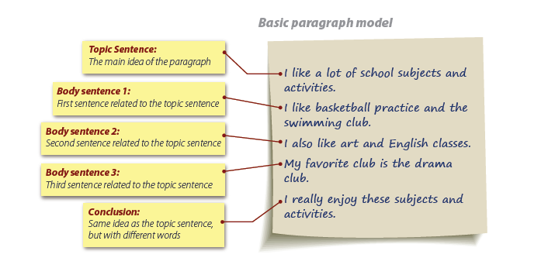
i-Learn Smart World 6 – Theme 2
Page 118

